Slide 1
ART 1600 – The Aesthetics of Architecture, Interiors, and Design Matthew Ziff, Associate Professor, Interior Architecture Area Chair Fall Semester 2015
Color & Light in Architecture, Interiors, and Design

Slide 2
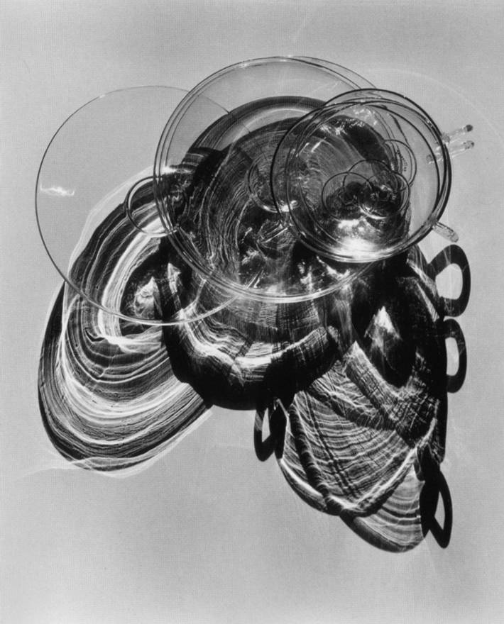
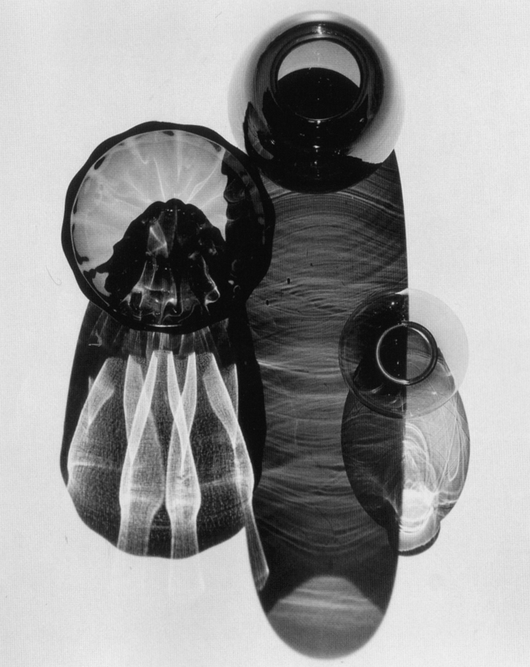

Slide 3
Color and Light
Color and Light are linked; without light, we see no color
Both color and light are ‘seen’ and how we see, physically (neuro transmission from the retina to the brain)
and what we see, conceptually, and emotionally, varies by person, across cultures, across time.

Slide 4
Stars produce heat, light, ultraviolet rays, x-rays, and other forms of radiation.

Slide 5
Light Sources Natural & Artificial
There are many sources of light. For us, the Sun produces all of our ‘daylight’, while artificial sources are mostly electric, along with fire in the form of candles, gas lights, torches.
The most common light sources are thermal: a body at a given temperature emits a characteristic spectrum of black-body radiation.
A simple thermal source is sunlight, the radiation emitted by the chromosphere of the Sun at around 6,000 Kelvin peaks in the visible region of the electromagnetic spectrum when plotted in wavelength units and roughly 44% of sunlight energy that reaches the ground is visible.

Slide 6
Light Sources: Natural & Man Made
Sun/Day light – light/heat from the sun.
Combustion – light/heat from combustion (fire).
Bio luminescence
Electrical (human made) – light/heat from human made sources.

Slide 7
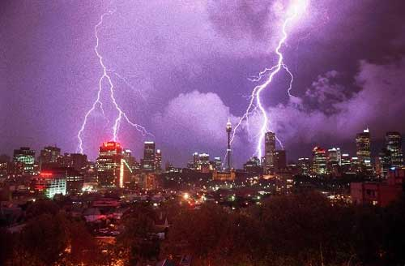
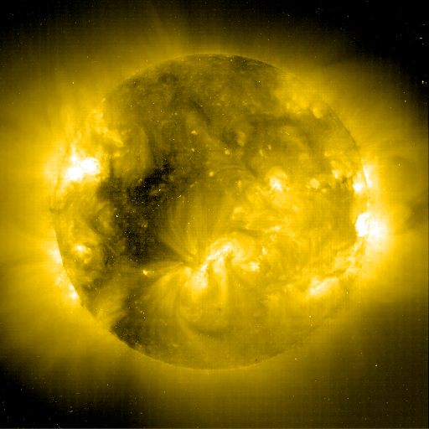
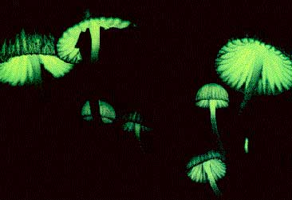
Sources of Light - Natural
Sunlight
Moonlight (sun)
Bioluminescence
Lightning

Slide 8
Electrical Light Sources
Lamp = Light bulb – the housing producing the source of light
Luminaries – the lighting fixture that includes the lamp
Light source properties
Initial Cost
Operating Cost
Color Rendering Index (CRI)
Color Temperature
Ballast / Transformer requirements
Instant on / off
Directionality
Efficacy
Lamp Life
Temperature requirements
Heat generated
Noise generated

Slide 9
Electric Light Sources
Incandescent lamps
Incandescent
Halogen
Discharge lamps
Fluorescent
Cold Cathode ‘Neon’
(HID) High Intensity Discharge
(LED) Light Emitting Diode

Slide 10
LED Lighting (a 3 minute video)

Slide 11
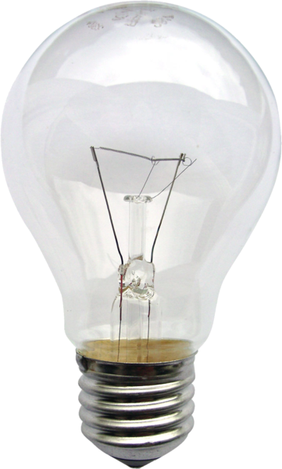
Another example is incandescent light bulbs, which emit only around 10% of their energy as visible light and the remainder as infrared. 90% of the energy used by these bulbs is emitted as heat.
They are really ‘heaters’ that give off some light.
A common thermal light source in history
is the glowing solid particles in flames, but
these also emit most of their radiation in
the infrared, and only a fraction in the visible
spectrum.

Slide 12
Lighting: Fluorescent
Most common commercially used light source
How it works: electrons are released into a glass tube covered with phosphors. These electrons excites various metal vapors (mercury) and they release UV radiation that excite the phosphors to glow.
Properties:
Moderate initial cost
Inexpensive operating cost
CRI (color rendering index) is moderate to good (70 – 90)
Color Temperature is warm to cool
A ballast/transformer is required – electronic/magnetic
Expensive to dim
Instant on with electronic ballast not with magnetic
Provides diffuse light
Excellent efficacy at 70 lpw
Excellent lamp life
Prefers warmer temperature to operate most efficiently
Very little heat is generate (still warm to touch)
Magnetic ballast produce humming / buzzing sound, electronic not as bad.

Slide 13
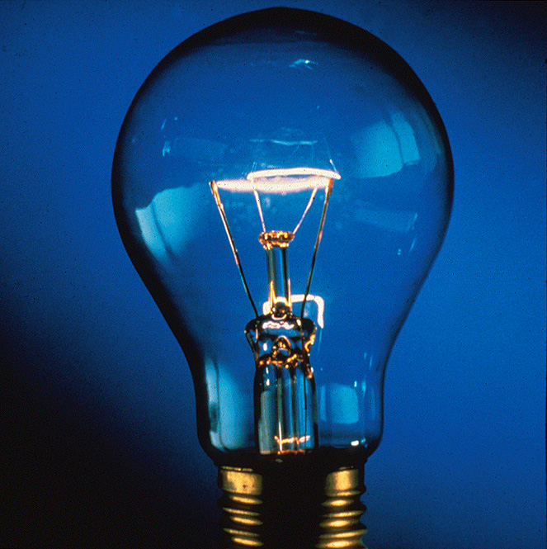
Incandescent Lamps
Operation
Varied shapes and sizes lamps but the process of operation is the same.
Electricity passes through a wire in a glass bulb with filled with a gas such as argon, nitrogen, halogen or a vacuum. The resistance to the electricity in the wire causes the wire or filament to heat to the point of incandescence. When a material incandesces it produces visible light.
Filament
Bulb
Base

Slide 14
Bioluminescence is a naturally occurring form of chem-iluminescence where energy is released by a chemical reaction in the form of light emission.

Slide 15
Bioluminescent Organisms

Slide 16
Sunlight filtered through atmosphere

Slide 17
Visible light is electromagnetic radiation that is visible to the human eye
Light is energy, photons, moving, very fast.
Color is light, reflected, or transmitted through material, of specific wavelengths.
The visible spectrum for human beings is rather small; we cannot see things that many animals can see, such as ultraviolet light, infrared light, et cetera.

Slide 18
Humanly visible light has a wavelength in the range of about 380 nanometres to about 740 nm – between the invisible infrared, with longer wavelengths and the invisible ultraviolet, with shorter wavelengths.
The speed of light in a vacuum is defined to be exactly 299,792,458 meters per second
(approximately 186,282 miles per second)

Slide 19
Architectural Lighting is classified in three categories Ambient, Task, Accent
Ambient Light: General Overall Lighting. (For general tasks such as navigating through space.)
The light that strikes most of the surfaces.
Task Lighting: for specific tasks. (Specific tasks that require accuracy and or efficiency.)
Accent Lighting: provided for aesthetic or visual interest. (Research indicating that it is an important aspect of overall environmental experience.)

Slide 20
The design of a single space may include ambient, task and accent lighting. A single light source may provide one or all three classifications.
When analyzing light classifications study where the light is falling then track it back to the source.

Slide 21
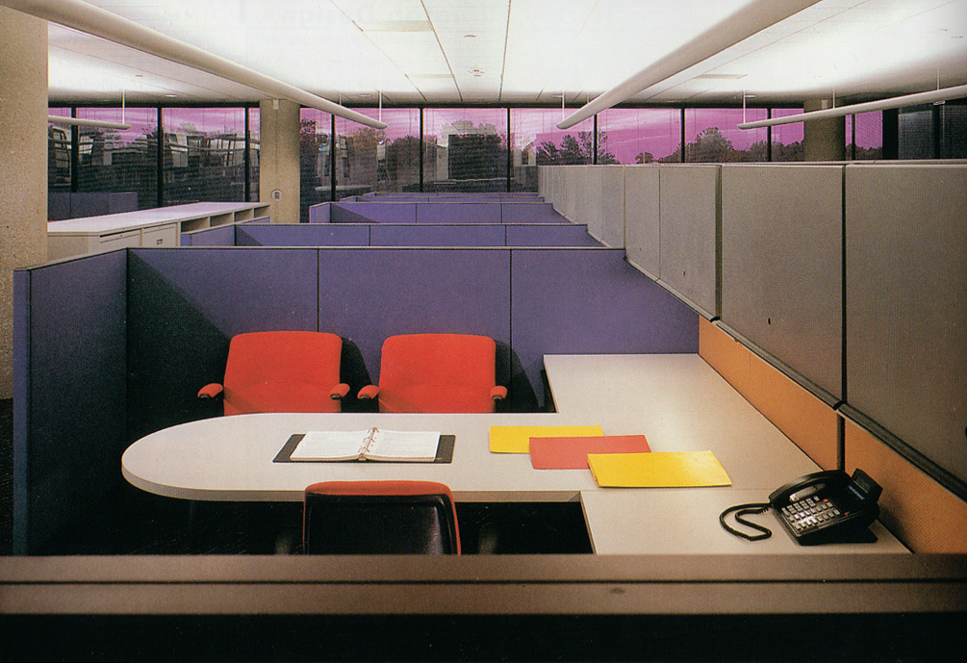
Ambient Light

Slide 22
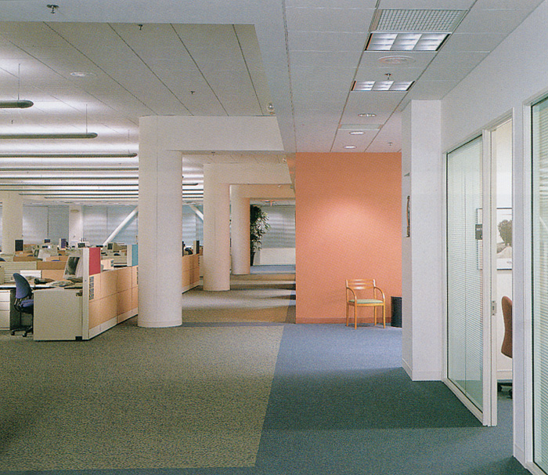
Ambient Light

Slide 23
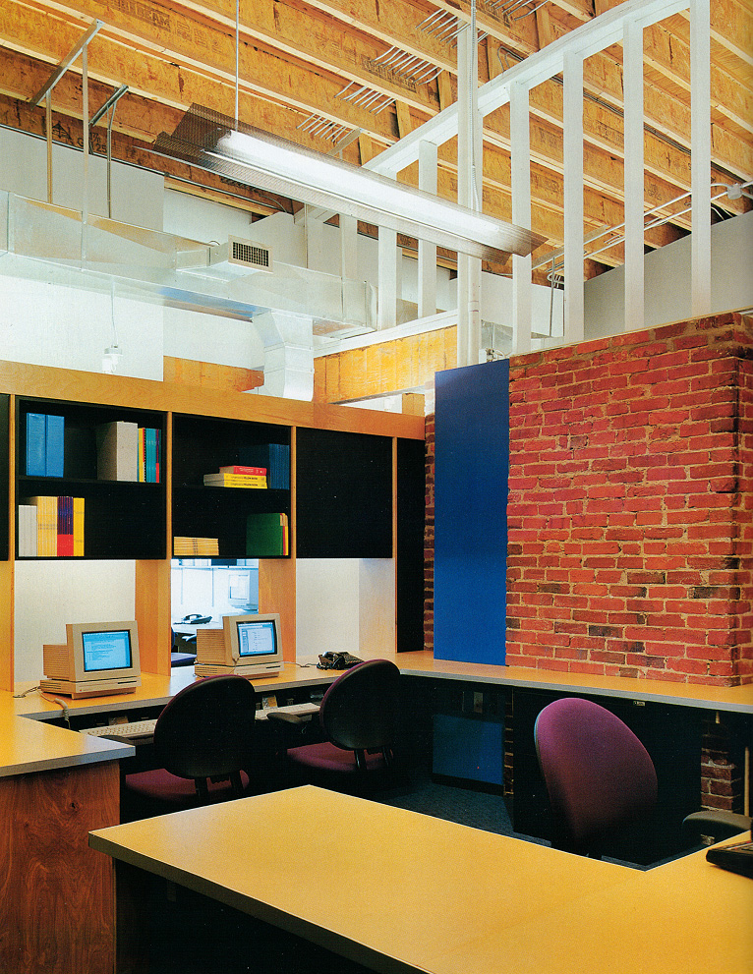
Ambient Light

Slide 24
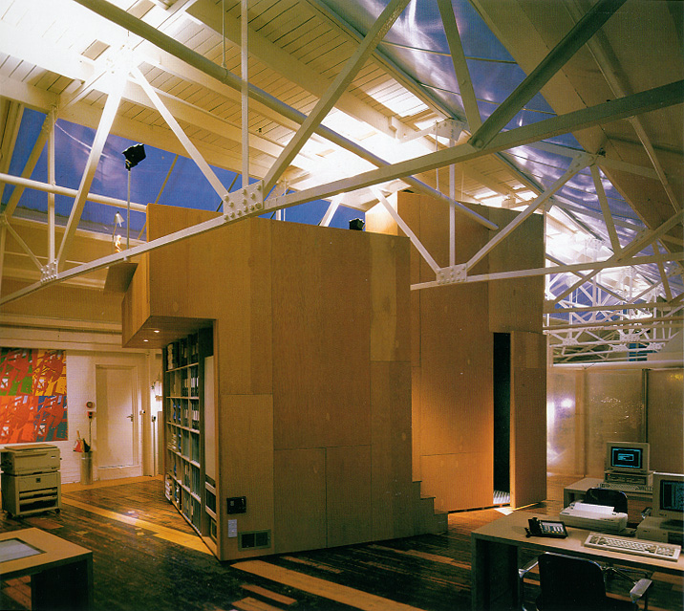
Ambient Light

Slide 25
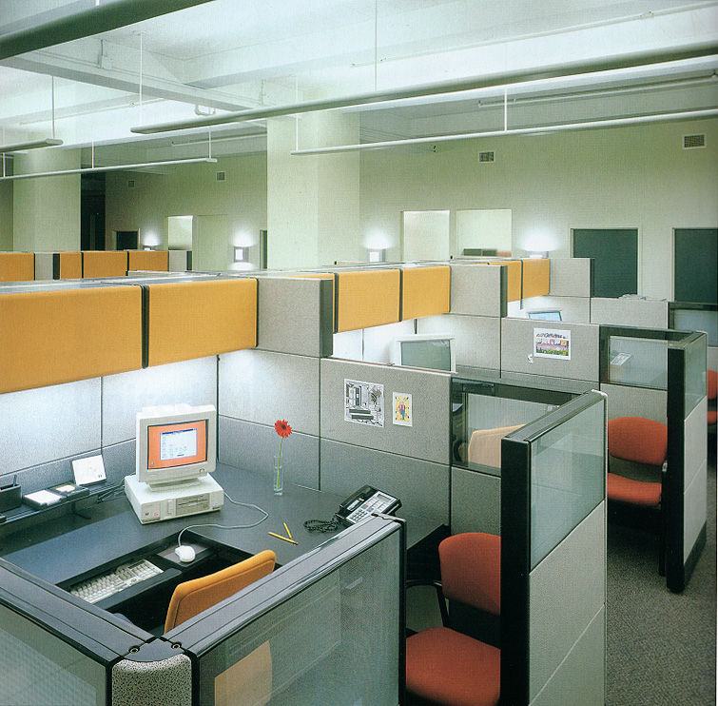
Task Light

Slide 26
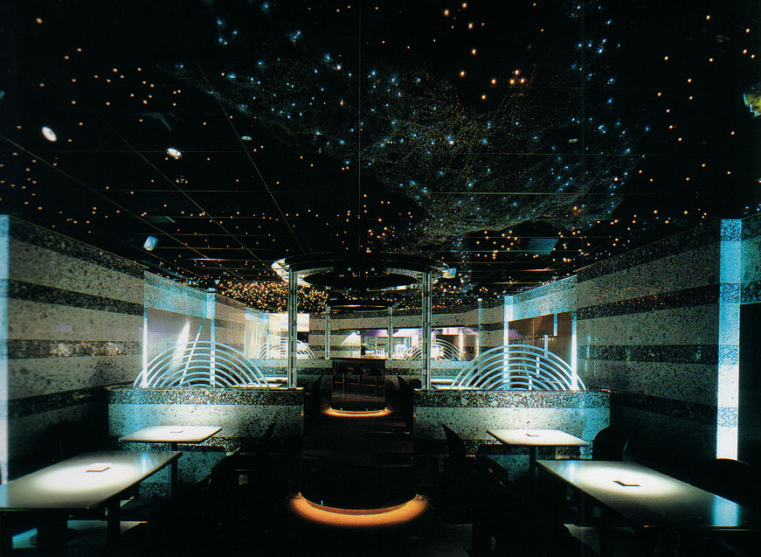
Task Light

Slide 27
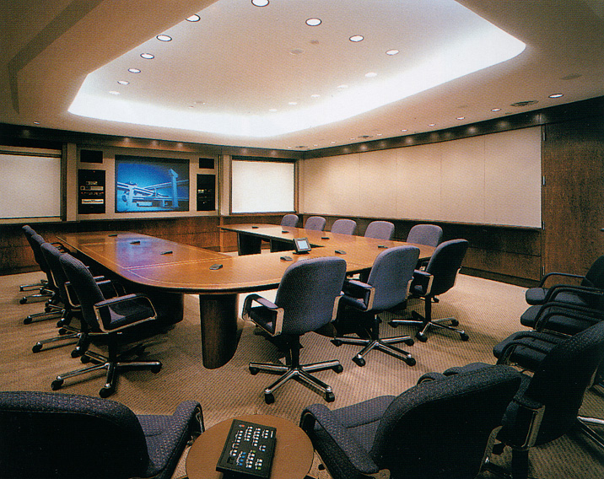
Task Light

Slide 28
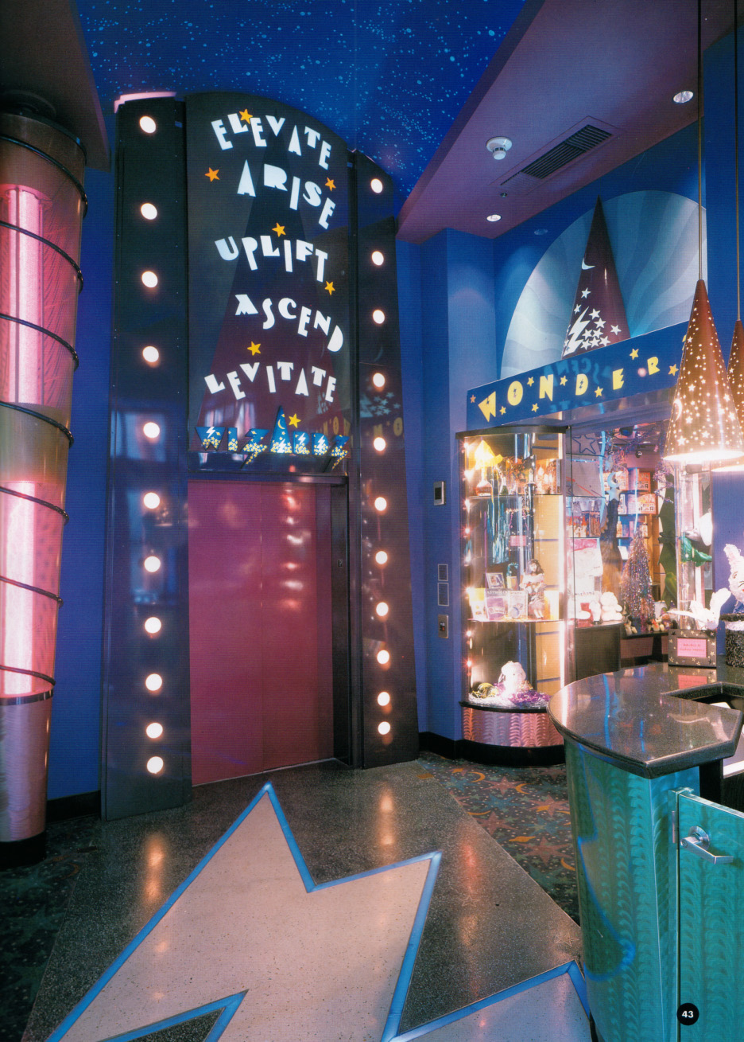
Accent Light

Slide 29
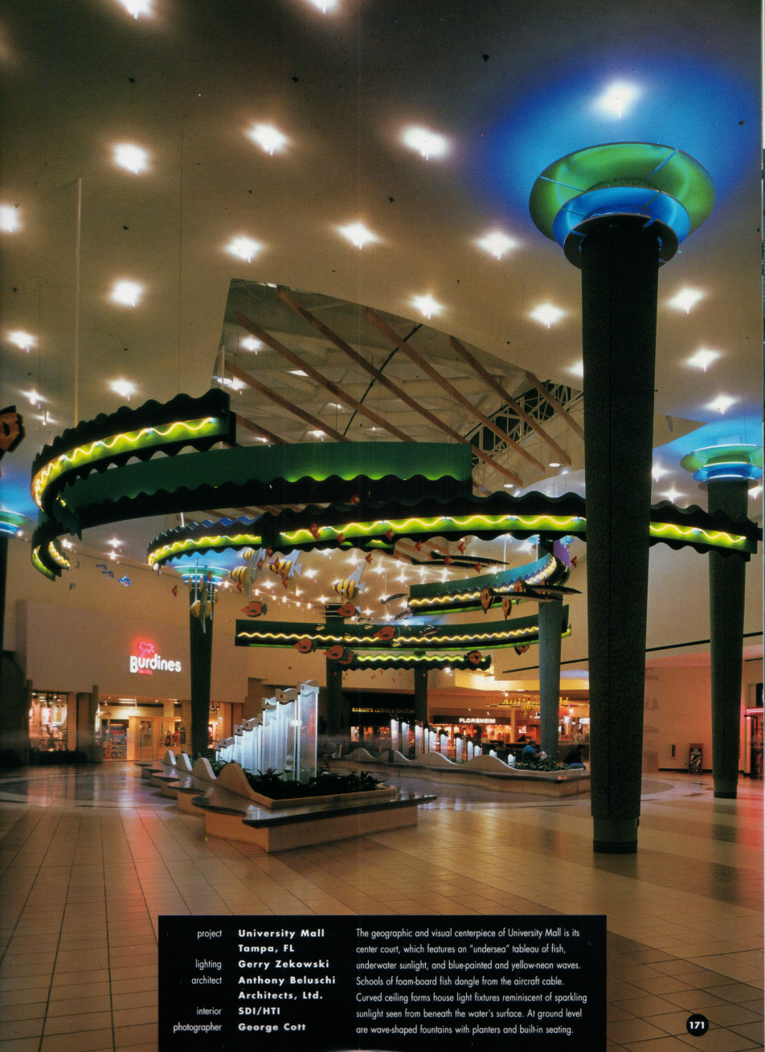
Accent Light

Slide 30
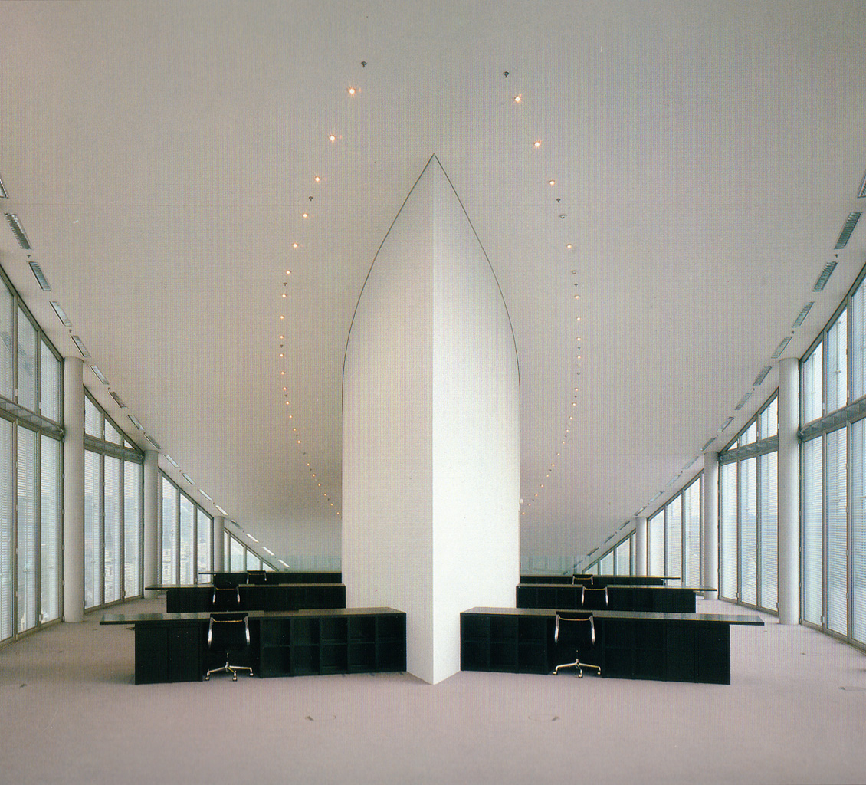
Accent Light

Slide 31
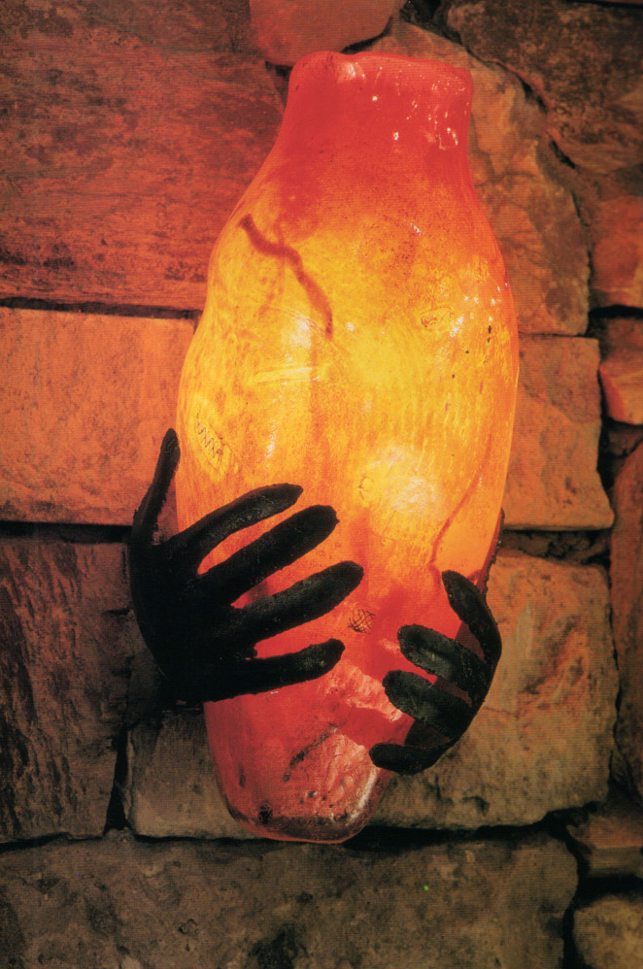
Accent Light

Slide 32
Visual Acuity
The measure of ones ability to see fine detail. This ability to see fine detail decreases with age. Visual acuity is based on five factors:
Visual Angle
Luminance
Time
Contrast
Color

Slide 33
The amount of light falling on the surface of an object can influence visual acuity.

Slide 34
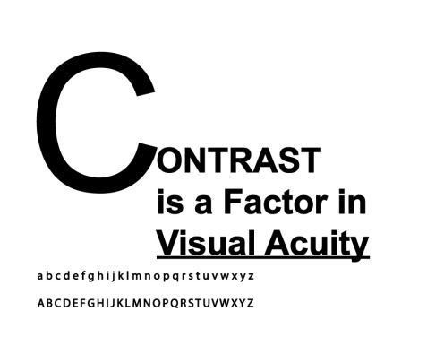
Contrast & Visual Acuity

Slide 35
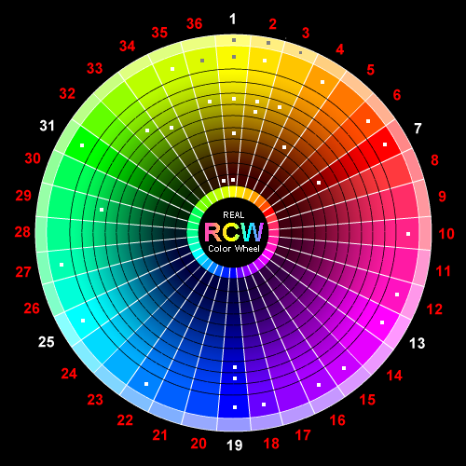
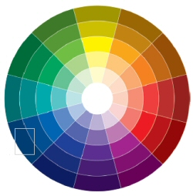
Color: a palette is a structured set of relationships

Slide 37
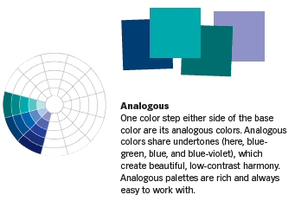

Slide 38
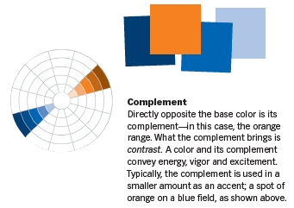

Slide 39
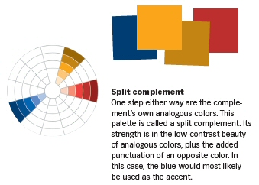

Slide 40
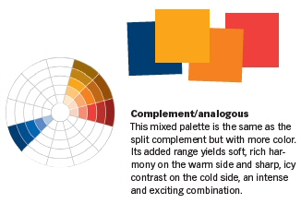

Slide 41
What is color theory?
Color Theory is a set of principles used to create harmonious color combinations.
Color relationships can be visually represented with a color wheel — the color spectrum wrapped onto a circle.
The color wheel is a visual representation of color theory:

Slide 42
History of color theory
The first color wheel was invented by Sir Isaac Newton. He split white sunlight into red, orange, yellow, green, cyan, and blue beams; then he joined the two ends of the color spectrum together to show the natural progression of colors. Newton associated each color with a note of a musical scale.
The current form of color theory was developed by Johannes Itten, a Swiss color and art theorist who was teaching at the School of Applied Arts in Weimar, Germany. This school is also known as 'Bauhaus'. Johannes Itten developed 'color chords' and modified the color wheel. Itten's color wheel is based on red, yellow, and blue colors as the primary triad and includes twelve hues.

Slide 43
Color Systems
http://www.worqx.com/color/color_systems.htm

Slide 44
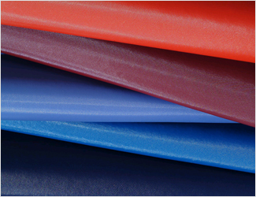
saturated color

Slide 45
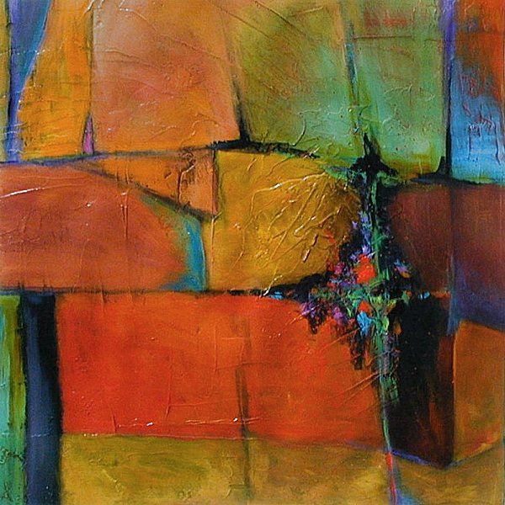

Slide 46
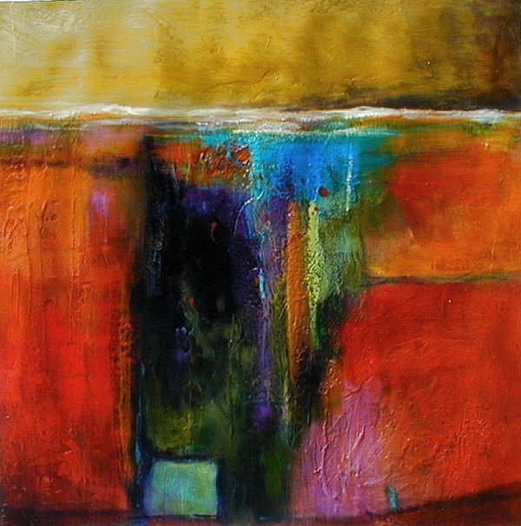

Slide 47
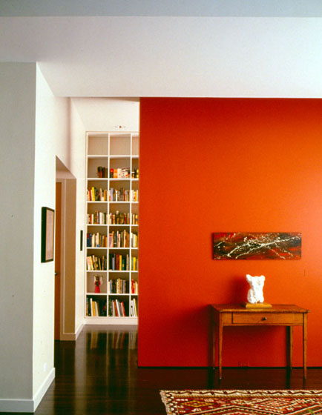

Slide 48
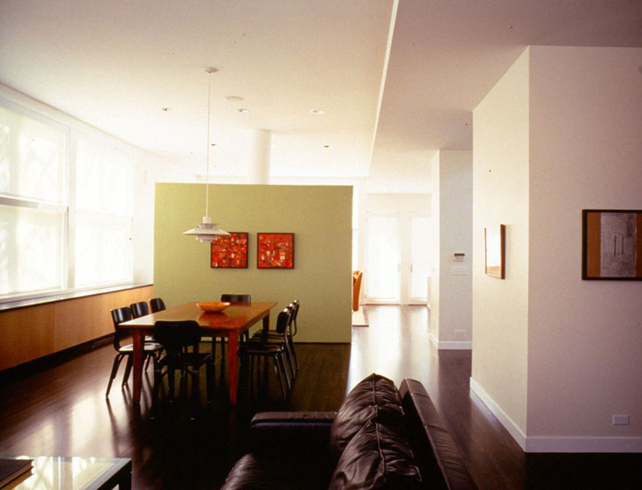

Slide 49
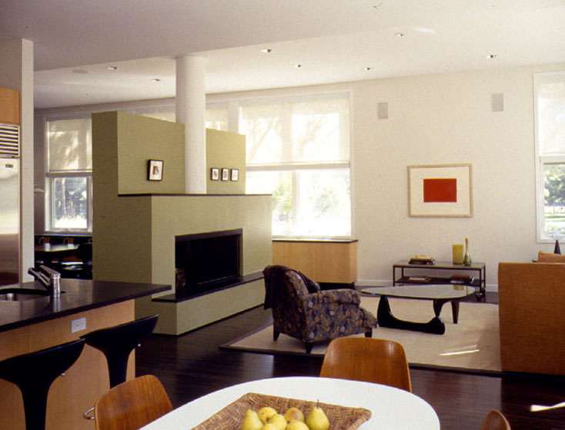

Slide 50
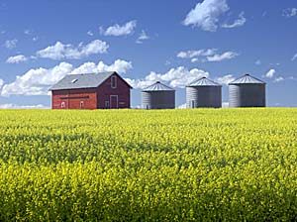
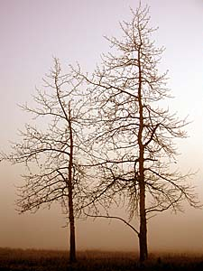

Slide 51
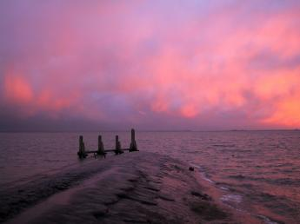
analogous colors

Slide 52
Colors and their corresponding wavelengths

Slide 53
R O Y G B I V an acronym for the sequence of colors in the rainbow red, orange, yellow, green, blue, indigo, violet

Slide 54
Sir Isaac Newton's (1666) color wheel is made up of 12 colors, which are classified into three categories

Slide 55
In 1666, Sir Isaac Newton performed a prism experiment in which he discovered that pure white light contains the full spectrum of colors — in effect, creating the world’s first color wheel.
From there, philosophers, scientists, artists and designers have continued studying the components of color and its physical, psychological and philosophical effects.

Slide 56
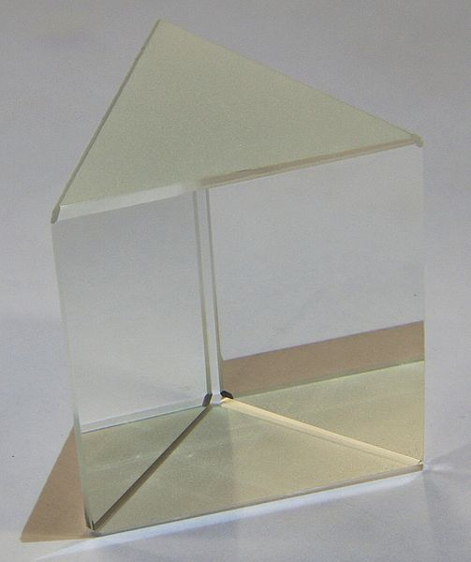
In optics, a prism is a transparent optical element with flat, polished surfaces that refract light.
At least two of the flat surfaces must have an angle between them.
Light changes speed as it
moves from one medium
to another (for example,
from air into the glass of the prism).
This speed change causes the light
to be refracted and to enter the new
medium at a different angle

Slide 58
White light is separated into individual wavelengths (colors) by passing through a prism

Slide 59
Primary Colors: Red, Yellow and Blue

Slide 60
Secondary Colors: Orange, Green and Violet Secondary colors are created by mixing primary colors.

Slide 61
Tertiary Colors are a combination of a secondary color and a primary color next to it. They include yellow-orange, red-orange, red-violet, blue-violet, blue-green and yellow-green.

Slide 62
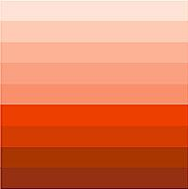
Creating a Color Palette specific combinations of colors to allow different materials, spaces or objects to ‘speak’ in a distinct color voice.
One Color Palette — Monochromatic
one color (hue) in varying values and intensities from light to dark.

Slide 64
Room with monochromatic color palette

Slide 65
Analogous Palette

Slide 66
Complementary Palette

Slide 67
Triad Palette A triad scheme is balanced. It's made up of any three colors that form a triangle in the center of the wheel.

Slide 68
Hue, Value, Intensity
These are the three characteristics of the colors on the wheel.
Hue is commonly used interchangeably with the word color but technically refers to the pure spectrum colors in the color wheel.
Value of a hue is determined by adding white to create a tint, black to create a shade or gray to create a tone.
Intensity, or saturation, or chroma, is the purity or brilliance of the hue.

Slide 69
This ‘hue’ is red adding white = tint adding black = shade adding grey = tone

Slide 70
Additive color mixing in theory this is what happens when using light

Slide 71
Subtractive Color Mixing This describes the effects of mixing paints, dyes and inks

Slide 72
CMYK is a color model for print/artwork/publication
C = cyan
M = magenta
Y = yellow
K = a key color, usually either white or black

Slide 73
CMYK Color
The CMYK model works by partially or entirely masking colors on a lighter, usually white, background.
The ink reduces the light that would otherwise be reflected.
Such a model is called subtractive because inks "subtract" brightness from white.

Slide 74
In additive color models, such as RGB, white is the "additive" combination of all primary colored lights, while black is the absence of light.
In the CMYK model, it is the opposite: white is the natural color of the paper or other background, while black results from a full combination of colored inks.
To save money on ink, and to produce deeper black tones, unsaturated and dark colors are produced by using black ink instead of the combination of cyan, magenta and yellow.

Slide 75
RGB color process is used for video screens
CMYK color process is used for print material

Slide 76
Professor Albert H. Munsell he taught at the Massachusetts Normal Art School

Slide 77
Munsell color system

Slide 78
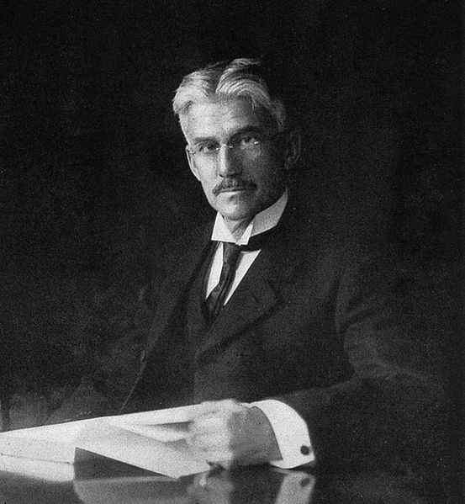
Munsell Color System
In colorimetry, (the science of human color perception) the Munsell color system is a color space that specifies colors based on three color dimensions: hue, value (lightness), and chroma (color purity).
It was created by Professor Albert H. Munsell in the first decade of the 20th century and adopted by the USDA as the official color system for soil research in the 1930s.

Slide 79
The idea of using a three-dimensional color solid, like a sphere, to represent all colors was developed during the 18th and 19th centuries.
Munsell wanted to create a “rational way to describe color” that would use decimal notation instead of color names (which he felt were “foolish” and “misleading”) which he could use to teach his students about color.
He first started work on the system in 1898 and published it in full form in A Color Notation in 1905.

Slide 80
Munsell color book pages

Slide 81
Munsell color pages

Slide 82
3 different views of the 3-d Munsell color system

Slide 84
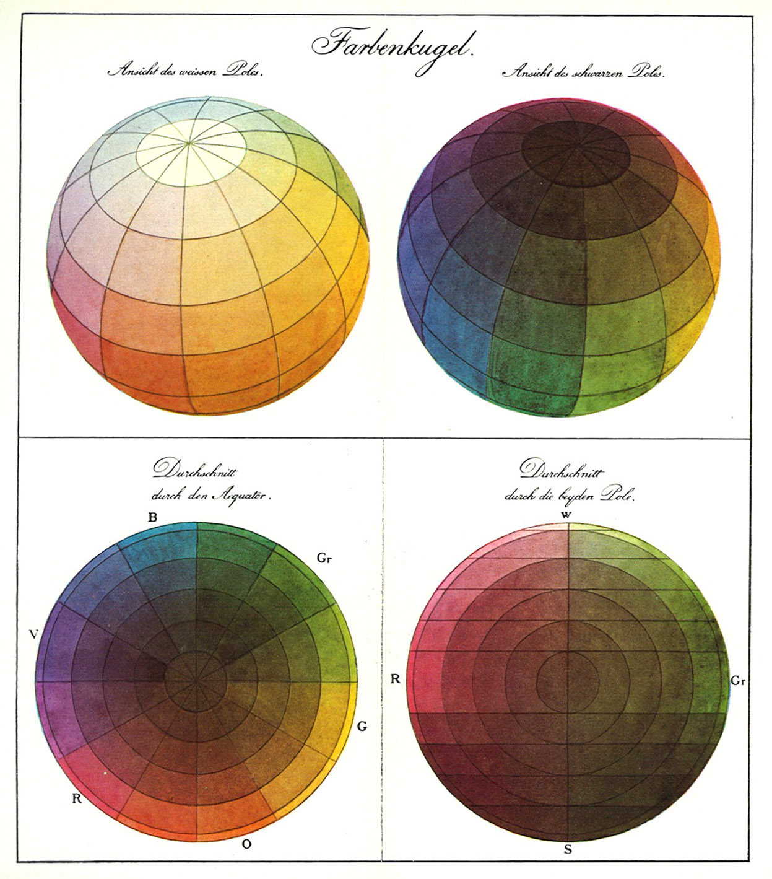
Phillip Otto Runge’s (1777-1810) ‘Color Sphere’ he was a German romantic painter

Slide 85
Adobe Technical Guides Web Page: Color Models

Slide 86
2012 Fiat 500 'Stinger’ an example of ‘blackened yellow’

Slide 93
The color alone (not material, or form) gives this room its visual character

Slide 94
Green and orange are complimentary colors: each makes the other stand out

Slide 95
White functions as a neutral against the greenish hues

Slide 96
Color alone has a big impact on the feeling, emotion, of the space Apartment designed by Head Architecture, 2010

Slide 99
Complimentary: red – green white as a neutral & light source

Slide 100
Green & white in a ‘living wall’

Slide 101
Black & white with highlights of color

Slide 102
Color & Light Mexican restaurant design at one of the FRIDA Mexican Cuisine Restaurant Group in Glendale , California. Designed by ICS restaurant builders

Slide 105
The Garden of colors restaurant by Gamelli Design

Slide 109
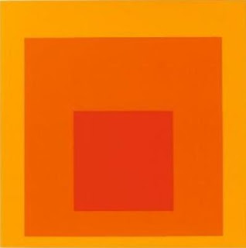
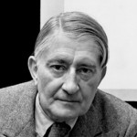
Artists known for their color studies
Josef Albers: 1888 – 1976, taught at the Bauhaus
“Homage To The Square” a large series of works.

Slide 110
Josef Albers
In his series titled Homage to the Square, Albers produced an extensive body of variations on a highly focused theme.
Homage to the Square is a collective exploration of color and spatial relationships

Slide 111
Robert Swain
Robert Swain’s paintings are the result of an intense 40-year study of color perception.
Standing in front of one of his 10-foot canvases, arranged in a mathematically formulated grid to minimize perceptual variables and making color interaction their main concern there is no denying color has transcendent properties.

Slide 112
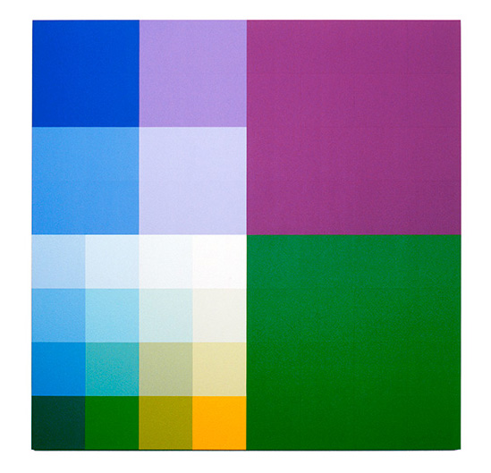

Slide 113
Matthew Ziff "My Understanding of Color"
When we look at color, two things (at least) are happening:
1. A retinal – brain stimulation: the simple physics of the wavelengths of the colored light striking our eyes, being ‘seen’ by our brains.
2. An emotional, personal, cultural, associational interpretation of the color.

Slide 114
Which of the strips below, A or B, corresponds to the green strip positioned on the red and green field? This illusion is based on the effect of simultaneous color contrast.

Slide 115
There have been many studies and attempts to link specific colors to specific human responses, emotions, and behaviors.
There is, as of today, no credible evidence to support claims such as ‘blue makes you sleepy’, or ‘red makes you angry’.
Color is a complex phenomenon that individuals respond to in a context of culture, time, and personal associations.

Slide 116
Material, texture, color and form are all revealed with light

Slide 117
Room divider by Superieur is also a light source, providing subtle, diffused illumination

Slide 118
An illuminated section of a wall

Slide 119
‘Quadro curve luce’ a system of wall panels composed of a flat connecting part and a curved one which contains a hidden light source.

Slide 120
Understanding the Sun, Season and Time of Day
Claude Monet
Grain Stacks, 1891

Slide 121
Understanding the Light and Season
A pond in Upstate New York
Spring Summer Fall Winter

Slide 122
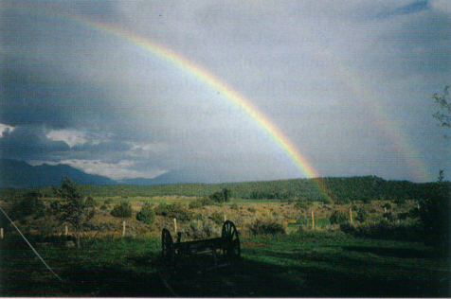
Understanding the Light and Place
Maine, 44 deg. North
Washington, 47 deg. North
Washington, 48 deg. North
Taos, NM 37 deg. North
Costal Washington, 48 deg. North

Slide 123
Understanding the Sun, Season and Time of Day
40 Degrees North Latitude, 82 degrees w west longitude; Columbus, OH

Slide 124
Site Analysis of Light and Physical Conditions
40 Degrees Latitude

Slide 125
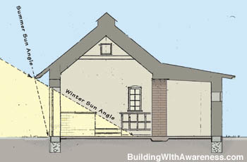
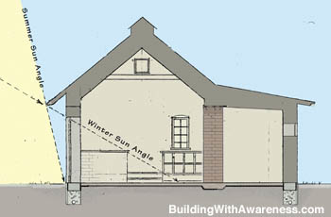
The position of the sun in the sky changes throughout the year

Slide 126
What causes winter and summer?

Slide 127
Ways to Capture Light in Spaces
Locate the space/building on the site so it receives light throughout the day.
Shape the space so light can enter every important room for at least two sides.
When light for a second side is not possible allow light from above.
Plan the placement of rooms so light is received at suitable times of the day.
Shape the size and shape of the opening (windows) to suite the activities and the climate.

Slide 128
Ways to Capture Light
Plan the details of design to create windows to the character of the space/building as a whole.
Use shading devises to control the amount of light and heat that enters the space/building.

Slide 129
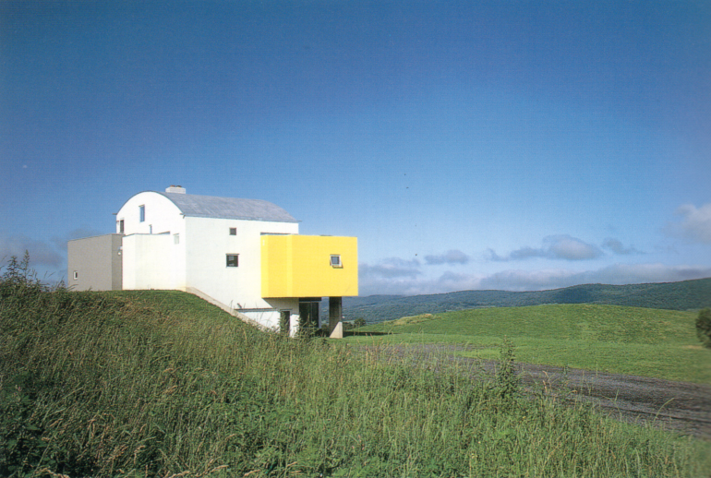
Locate the building on the site so it receives light throughout the day.
South facing façade of the home receives light thought most of the day.
Copake, New York
North facing windows provide privacy and allow light to enter the home in areas that require less light.
The northern exposure is protected.

Slide 130
Locate the building on the site so it receives light throughout the day.
Light is also entering most rooms from at least two directions.

Slide 131
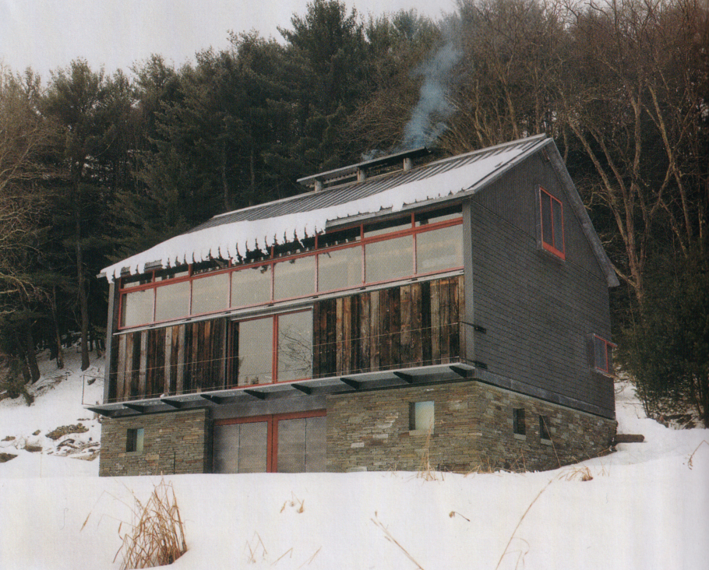
Locate the building on the site so it receives light throughout the day.

Slide 132
Locate the building on the site so it receives light throughout the day.

Slide 133
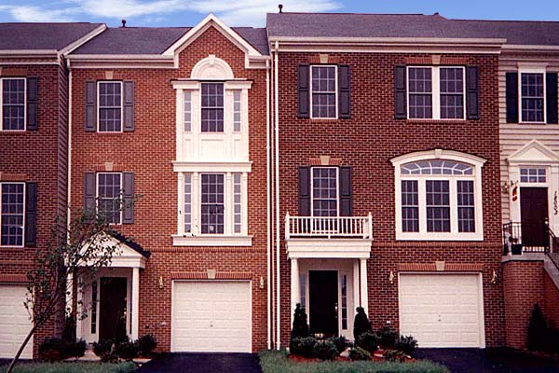
When possible shape the buiilding so light can enter every important room for at least two sides.
Townhouse in Rockville, MD
Light enters rooms from only one direction.

Slide 134
Shape the building so light can enter every important room for at least two sides.
Saticoy, CA
The intentional shaping of these buildings allows light to enter rooms from two directions.

Slide 135
Shape the building so light can enter every important room for at least two sides.

Slide 136
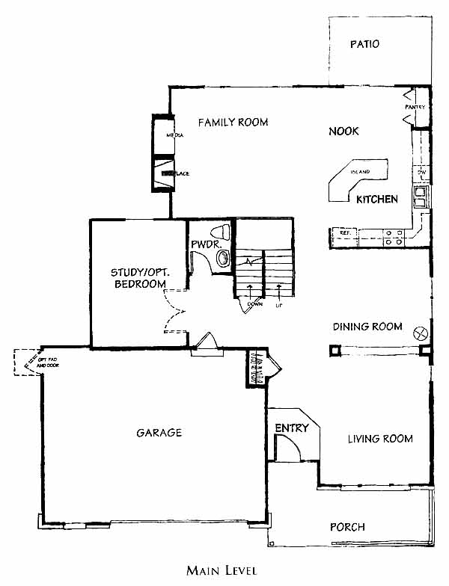
Shape the building so light can enter every important room for at least two sides.
Denver, CO
Light enters rooms from only one direction in most spaces.

Slide 137
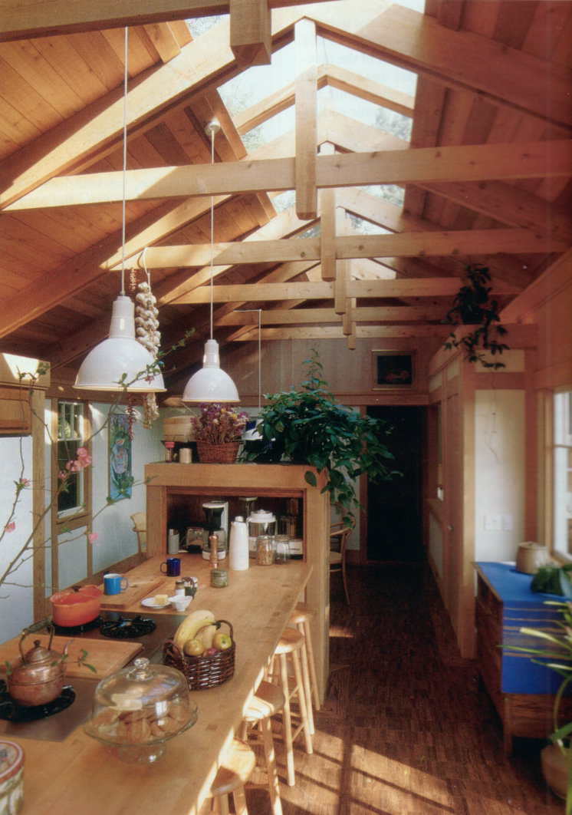
When light for a second side is not possible allow light from above.

Slide 138
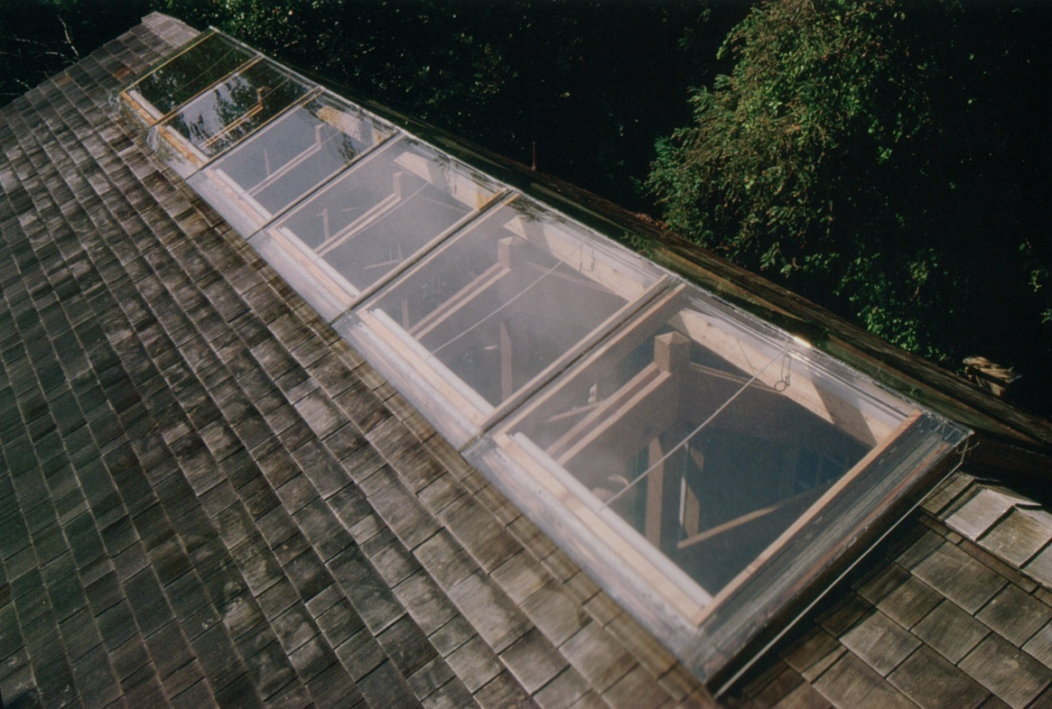
When light for a second side is not possible allow light from above.

Slide 139
Plan the placement of rooms so light is received at suitable times of the day.
Capturing Morning Light
The light has a more orange/yellow hue earlier in the day.

Slide 140
Plan the placement of rooms so light is received at desired times of the day.
Capturing light all day with a southern exposure.
The color of the light will shift during the day as a natural result of the movement of the sun and changing light angles.

Slide 141
Plan the placement of rooms so light is received at desired times of the day.
Capturing Evening Light
The light has a more orange/yellow hue later in the day.

Slide 142
Plan the placement of rooms so light is received at desired times of the day.
Capturing Evening Light.
Accentuates the forms, provides color on white surfaces.

Slide 143
Plan the placement of rooms so light is received at desired times of the day.
Capturing Evening Light
The light has a more orange/yellow hue later in the day.

Slide 144
Create the size and shape of the opening (windows) to suite the activities and the climate.
North Facing Studio
Strong link with light and nature.
Light enters the room from two directions.

Slide 145
Create the size and shape of the opening (windows) to suite the activities and the climate.
Laguna Beach, CA
Notice that the light can enter the room from two directions.

Slide 146
Create the size and shape of the opening (windows) to suite the activities and the climate.
Marin County, CA
Notice that the light can enter the room from two directions.

Slide 147
Create the size and shape of the opening (windows) to suite the activities and the climate.
The building takes advantage of the foliage of the trees.

Slide 148
Windows greatly influence the overall character of a space. Select window sizes, and types, to work with and create the kind of environment desired.

Slide 149
Select window sizes, and types, to work with and create the kind of environment desired.

Slide 150
Select window sizes, and types, to work with and create the kind of environment desired.

Slide 151
Select window sizes, and types, to work with and create the kind of environment desired.

Slide 152
Select window sizes, and types, to work with and create the kind of environment desired.
Planning of the windows provides privacy on the front of the home.

Slide 153
Select window sizes, and types, to work with and create the kind of environment desired.

Slide 154
Select window sizes, and types, to work with and create the kind of environment desired.

Slide 155
Select window sizes, and types, to work with and create the kind of environment desired.

Slide 156
Use shading devises to control the amount of light and heat that enters the space.

Slide 157
Use shading devises to control the amount of light and heat that enters the space.

Slide 158
Use shading devises to control the amount of light and heat that enters the space.

Slide 159
Use shading devises to control the amount of light and heat that enters the space.
Electronically controlled blinds

Slide 160
Use shading devises to control the amount of light and heat that enters the space.
Landscaping elements to control light and heat.

Slide 161
Light as Image of Nature
Frank Lloyd Wright Window

Slide 162
Light as Image of Nature
Tiffany Lamps and Stained Glass

Slide 163
Light and Materials

Slide 164
Light and Form

Slide 165
Light Can Reveal Structure

Slide 166
Light Can Expand Space

Slide 167
Steven Holl, American architect known for his designing with light and color.
http://www.youtube.com/watch?v=Z1EdclmS7wE&feature=related
Video of the ‘Sun Slice House’ by Steven Holl
http://www.youtube.com/watch?v=MDJIiUHObgw&feature=related
Video of the ‘Knut Hamsun Center’ by Steven Holl

Slide 168
SUN SLICE HOUSE Lake Garda, Italy, 2006, Steven Holl, Architects

Slide 172
Slices of natural light and their change in space throughout the day and year is the focus of the house.
The steel frame and concrete structure is skinned with an alloy of copper, steel, chromium, and nickel, which weathers to a leathery red color.
Interiors are white plaster with terrazzo floors on the ground level.

Slide 173
Steven Holl watercolors: these are studies for the design of possible interior and exterior architectural conditions

Slide 178
DAEYANG GALLERY AND HOUSE Seoul, Korea, 2008-June 2012, Steven Holl, Architects

Slide 182
PLANAR HOUSE AZ, United States, 2002-2005, Steven Holl, Architects

Slide 187
This house is designed using light as a creative, enriching experience

